Slide 1
A History of American Whiteness
The Social Construct of Race in America
www.OARonline.org

Slide 2
THIS PRESENTATION IS FOR OAR USE ONLY
Although the information presented in this presentation has been compiled from a number of different sources, this presentation was specifically created for OAR's Racial Justice Cohorts and programs.
We ask that you please only refer back to this presentation for your own use and reference and do not share this presentation online or to the public without permission from OAR.
Thank you
www.OARonline.org

Slide 3
Sankofa
Is an African word from the Akan tribe in Ghana. The literal translation of the word and the symbol is “it is not taboo to fetch what is at risk of being left behind”
San (return)
Ko (go)
Fa (look, seek, and take)
www.OARonline.org

Slide 4
The First British Settlement
White people did not exist before 1681
Bacon’s Rebellion in 1676 in Jamestown Virginia caused a major paradigm shift in the new colony
After 1676 laws and legislation were used to intentionally legalize whiteness as a privileged status and as a matter of law
www.OARonline.org

Slide 5
Maryland and Virginia Colonies
Both were British Colonies and had similar characteristics
Their economies were rooted in tobacco (tremendous labor) and required lots of workers
Incredible gender imbalance. Between 8-12 men for every woman.
www.OARonline.org

Slide 6
Indentured Servitude
… Of his own free Will and Accord.
By 1530 the population of England and Wales had risen to around 3 million and by 1600 it was about 4 million.
There were lots of poor British people who were on the public dole.
Indentured and enslaved persons were sold and traded like cattle (Edmund Morgan American Slavery: The Ordeal of Colonial Virginia 1975)
www.OARonline.org

Slide 7
Laborers and Law: Not all laborers equal in terms of labor
North American Servitude
England Servitude
Indenture was for a term of 7-14 years protected by British Law
Slavery for Life: No British or International law to prohibit or restrict however the terms were different in North America as opposed to England.
Marriage and Family prohibited. If a woman servant became pregnant 7-9 yrs. was added on to her term, and one year to the father.
Indenture was for a year and was usually renegotiated.
In England Indentured servants could marry and have families. It was viewed as the way to produce the next group of workers.
www.OARonline.org

Slide 8
Socio-economic Ladder
Landholding Elite – Hugh gulf between 1% and all others
Laborers – the vast majority were British men. There were others from Scotland, Ireland, and even smaller numbers from Africa and Native Tribes.
Time period - early 1600’s
British Europeans Africans
Native tribes
www.OARonline.org

Slide 9
Social life
Little is known about the social life Pre- Bacon’s Rebellion. The Social context at this juncture within the Jamestown Colony is obscure.
What we do know, is that British and African Laborers lived, ate, worked, and slept together.
Faced same opportunities to advance, once one was free of their term of service.
www.OARonline.org

Slide 10
Note:
Poor British men constituted the vast-majority of the population in both the Colony of Maryland and the Colony of Virginia.
All men FREE of indenture or enslavement faced the same opportunities in these colonies as a matter of law.
- could own servants
- could vote
- could marry person of opposite sex
regardless of national origin (race did not exist)
Miscegenation – Interbreeding of people considered to be of different races
According to records of laws from this time period (early 1600’s) there were no anti-miscegenation laws on the books.
There was push back on some of these marriages, but it did not come from the masses. It came from the elite.
www.OARonline.org

Slide 11
Maryland Colony Lawmakers
In 1664 passed a law punishing British and other freeborn women who marry enslaved Black men. The punishment for entering into these marriages was:
The woman would be enslaved for the duration of the husband’s life
Any children they have would be enslaved until their twenties
Important to note: These laws were not aimed at elevating social status of one group over another. There still was no record of the term white in any records as it referenced a group of people. It was aimed at three primary problems in the colony.
www.OARonline.org

Slide 12
Anti-miscegenation law
Law punished or prohibited marriage between a white person and specific nonwhite persons.
Not derived from British Common Law but an invention of North American Colonial lawmakers.
Important because it is where white referencing a group first appears
Lasted more than 300 years from 1664 until held unconstitutional in 1967 in
Loving v. Virginia (A Black woman and her white husband from Caroline County Va.)
www.OARonline.org

Slide 13
Anti-miscegenation law
Major Laws that helped create the Human Category White
1681 First appearance of WHITE
Referencing a group of humanity
Maryland Colony 1664 English or freeborn women “disgrace, forgetful of free status, enslavement
Maryland Colony 1681 Freeborn English and other white women punishment of slaveholders who encourage
Virginia Colony 1691 English or other white applied to men and women
www.OARonline.org

Slide 14
Maryland Colony Law of 1664
The specific issue that prompted the 1664 law, however, was the problem of baptized blacks who claimed their freedom. The Lower House of the Assembly outlined the problem for the Upper House:
It is desired by the lower house the upper house would be pleased to draw up an Act
obliging blacks to serve a term of life. They thinking it very necessary for the prevention
of the damage [that] Masters of such Slaves pretending to be Christians and so plead the
Law of England.
The Lower House clearly recognized Black slavery as a prior practice and implied that race distinction should be the only criterion for its continuance. It also recognized that such a policy would be in direct conflict with English Law, however justified it on the grounds that a valuable source of labor was at stake.
www.OARonline.org

Slide 15
The Law had four Provisions
All “Blacks or other slaves” (meaning Christian Blacks) whether already in the Province, or to be transported later, were to serve life.
All children born to any Black or other slave were to be “Slaves as their Fathers”
To discourage “dives free born English women” who, forgetful of free condition and to the disgrace of our Nation, marry slaves, thus inconveniencing courts and masters with legal debates over the status of the offspring, any free woman so marrying after the act’s passage was to serve her husbands lifetime.
To further discourage such marriages, the children of matches contracted after the act’s passage were to be slaves as their fathers were. The children of such marriages contracted before the act’s passage were to serve their parents’ masters until they reach the age of thirty-one.
www.OARonline.org

Slide 16
The Law of 1681
Throughout the latter part of the seventeenth century, the Assembly continually redefined aspects of Blacks slave status. In 1681 new laws were passed that superseded the one of 1664. The first two provisions of the new laws were virtually the same as the first two provisions of the earlier law. Africans were to serve for life and pass their condition to their offspring via paternal descent. But the provision bearing upon mixed marriages and children of mixed parentage were altered significantly. Beside the “disgrace” of mixed marriages mentioned in the 1664 law, the 1681 law lamented the connivance of masters who exploited the terms of the earlier law and forced freeborn female indentured servants to marry slaves.
…. for as much as diverse Freeborn English or White women sometimes by the instigation Procurement of Convenience of their Lascivious and lustful desires, and to the “disgrace” not only of the English but also of many other Christian Nations, do intermarry with Negroes and Slaves…
The most striking feature of the 1861 law is that it applied only to black male/white female marriages contracted under duress. Presumably, marriages contracted voluntarily were in no way subject to it. Furthermore, by repealing the 1664 law and specially exempting all children (mulattoes) of forced marriages.
www.OARonline.org

Slide 17
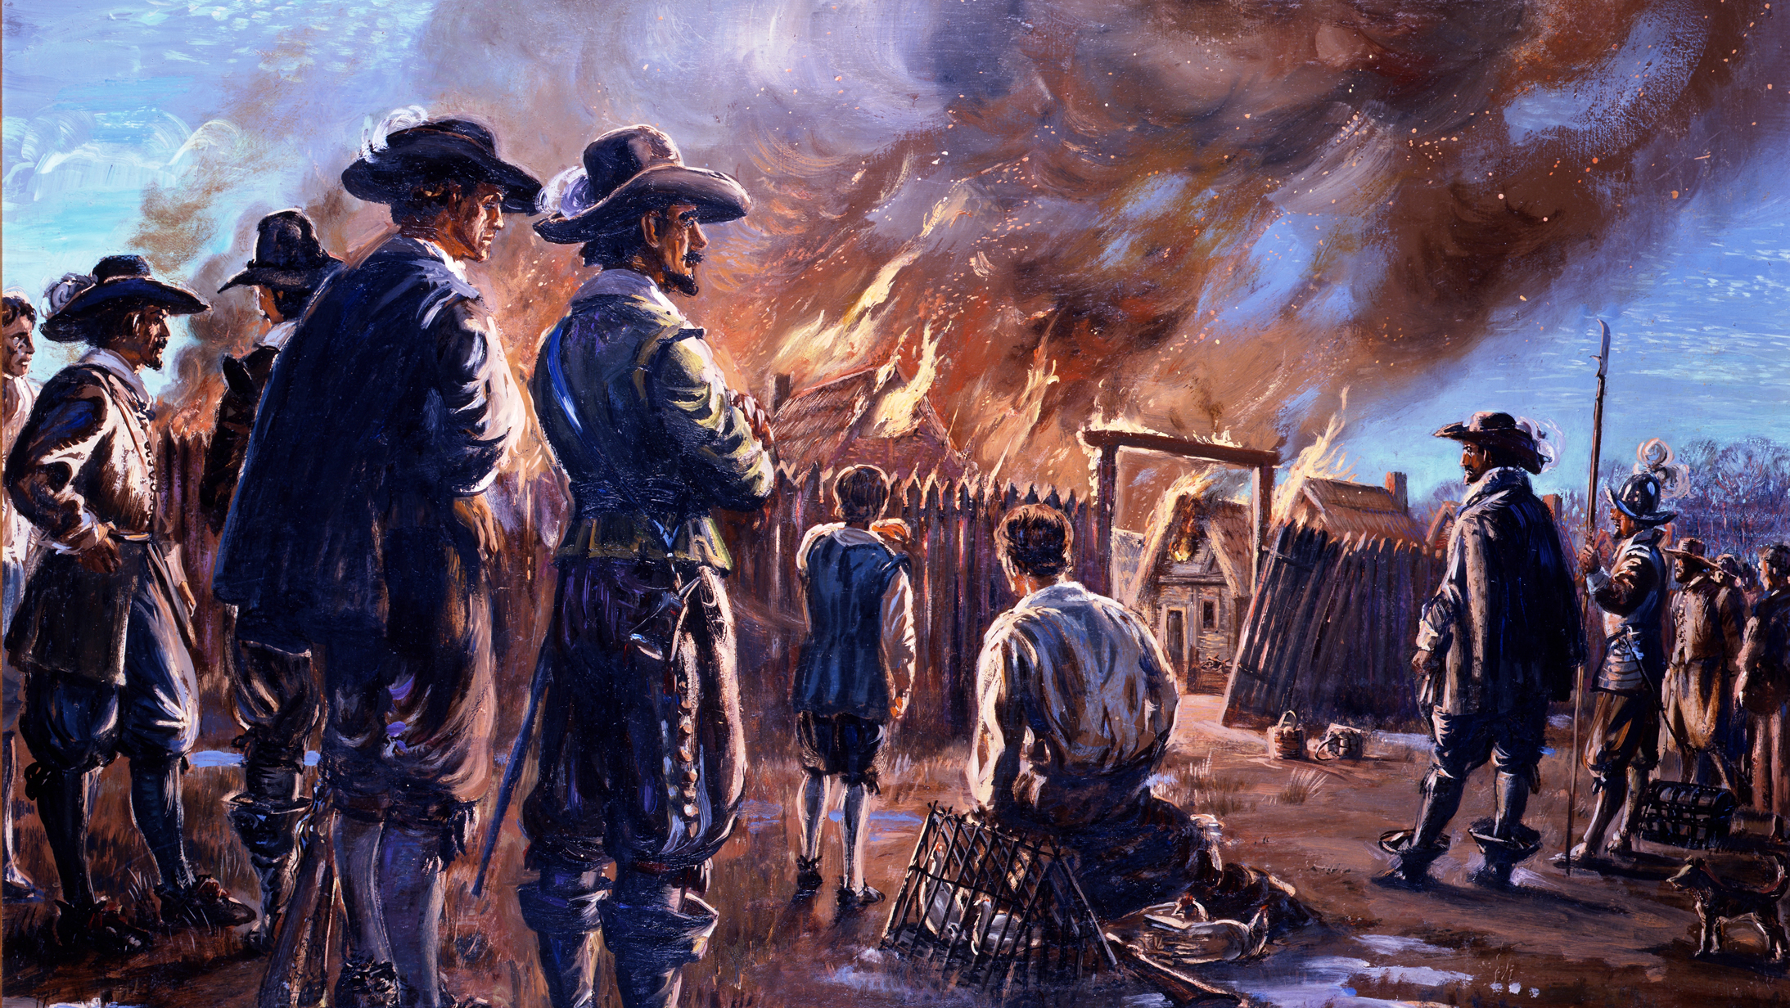
1664 ------------?------------1681
BACON’S REBELLION
JAMESTOWN 1676
www.OARonline.org

Slide 18
Seeds of Rebellion
A MASSIVE REVOLT THAT LASTED MORE THAN A YEAR
Readily available labor pool of poor British ended
European Bond laborers faced longer terms, harsher treatment
Large increase in number of enslaved Africans
Tobacco price dropped and taxes increased
Land and other opportunities for servants after term of service more limited
www.OARonline.org

Slide 19
Lessons of Bacon’s Rebellion
* A united labor force = threat to the form of capitalism taking hold in the colonies.
* Virginia lawmakers wrote a letter to the legal oversight authority in England indicating, the intent to use a divide and conquer strategy in order to prevent rebellion. (The Invention of White People, Theodore W. Allen, 1997)
* Ruling class alarmed by the natural alliance between slaves and servants during the rebellion
* After Bacon’s Rebellion Amnesty was given to whites, but not Blacks
* IT IS ONLY AFTER BACON’S REBELLION THAT WE SEE THE EMERGENCE OF “WHITE” PEOPLE AS A “SOCIAL GROUP”
www.OARonline.org

Slide 20
Divide and Conquer
FREE BLACKS prohibited from holding public office
BLACKS and NATIVE TRIBES prohibited from marrying WHITES
WHITES required to be paid goods including guns and powder.
FREE BLACKS prohibited from possessing weapons
BLACKS prohibited from testifying against WHITES
www.OARonline.org

Slide 21
Social Hierarchy
Patriarchal Power (White Men)
Pre-Bacon’s Rebellion
BOTTOM OF SOCIETY
Post Bacon’s Rebellion
enactments created a much
lower bottom to Colonial Society
Landholding Elite
Whites
Native American
Blacks
Blacks
Native Tribes
www.OARonline.org

Slide 22
White People
Built upon the IDEA of the British as:
- Christian
- Freeborn
- deserving of rights and privilege from which “others” can be denied
Legal Standard for whiteness = sufficiently British-like
White = tool by which laborers were divided
White = superior to nonwhite
White = worked to connect European laborers to the British elite
White = center of patriarchal power
There was no genetic shift – A human assertion of power
www.OARonline.org

Slide 23
The Naturalization Act of 1790
This was an Act of Congress set forth on March 4, 1790. This Law remained on the books until 1952
In order to become a Naturalized Citizen of this new country called the United States of America, one had to be white. This was valid law until 1952.
Note: In March of 1907 Congress passed the Expatriation Act, which decreed among other things, that U.S. women who married non-citizens were no longer citizens. (But none of these rules applied to American men when they chose a spouse)
www.OARonline.org

Slide 24
Requirements of WHITENESS in NATURALIZATION LAW
Evidence to deny U.S. Citizenship status and protections of constitution to persons of African decent see: Plessy v. Ferguson 1896
Used to Chinese and Japanese Immigrants dependent labor despite large numbers in western regions of the country.
If not White = NOT a U.S. citizen
If not citizen = NO political voice
Inability to voice needs allowed Chinese and Japanese to be paid less; allowed for imposition of a foreign wage tax; allowed for their exclusion from: public sector jobs; managerial positions; blocked them from challenging laws:
- illegal for a Chinese to testify against a white person;
- Alien Land Laws that made it illegal for those ineligible for Naturalization (i.e., not white) from owning land; and Anti Miscegenation law
www.OARonline.org

Slide 25
THE END
www.OARonline.org

