Slide 1
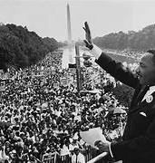
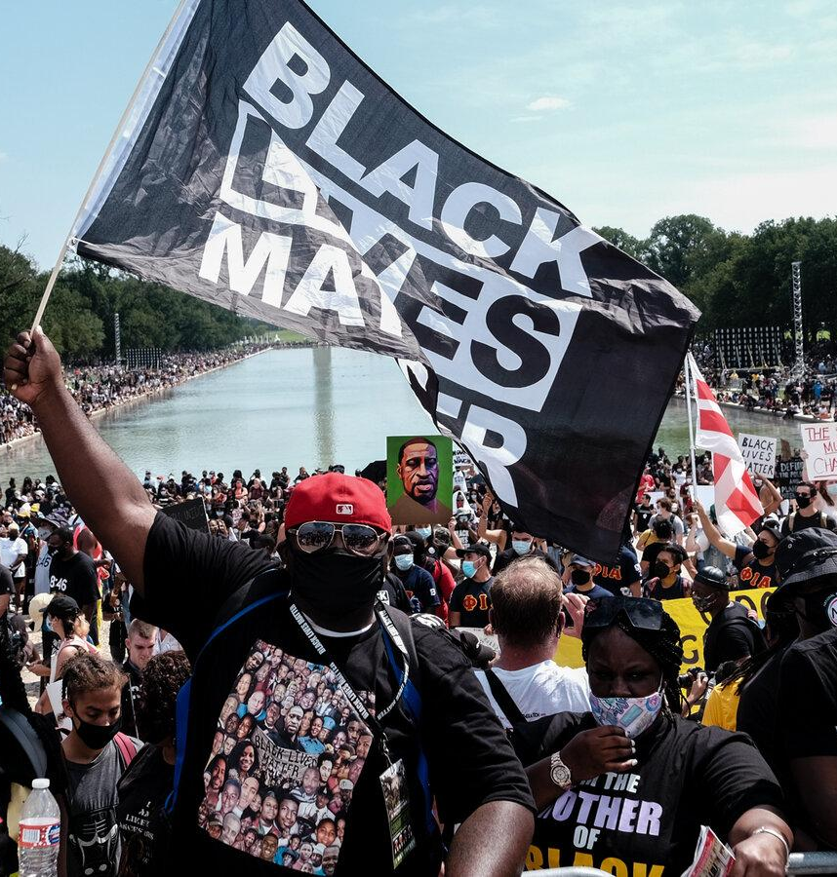
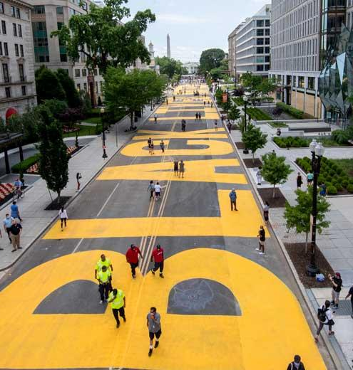
THE RACIAL JUSTICE JOURNEY
www.OARonline.org

Slide 2
this presentation is for OAR use only
Although the information presented in this presentation has been compiled from a number of different sources, this presentation was specifically created for OAR's Racial Justice Cohorts and programs.
We ask that you please only refer back to this presentation for your own use and reference and do not share this presentation online or to the public without permission from OAR.
Thank you
www.OARonline.org

Slide 3
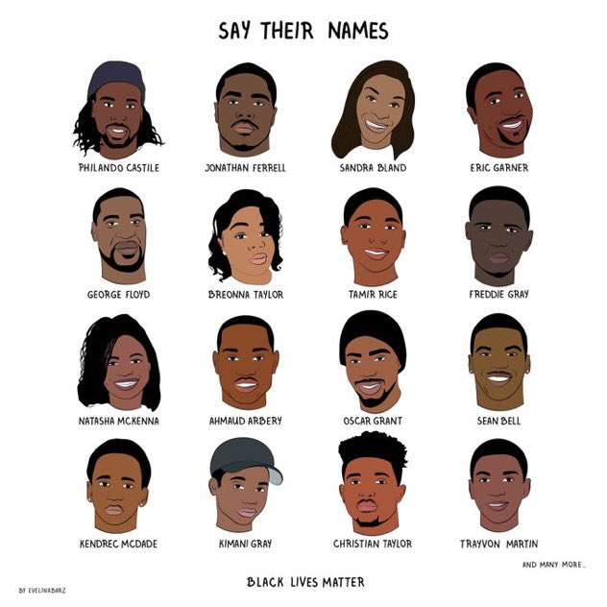
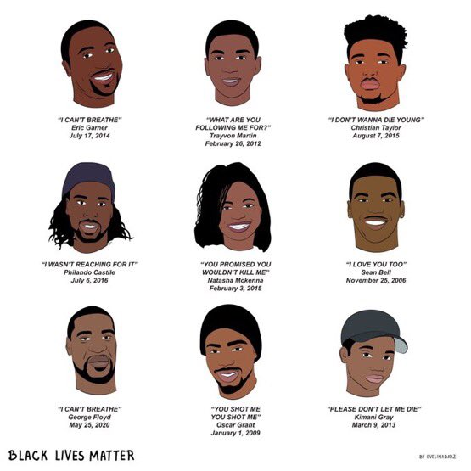
MOMENT OF SILENCE
And MANY more whose names are not mentioned..
www.OARonline.org

Slide 4
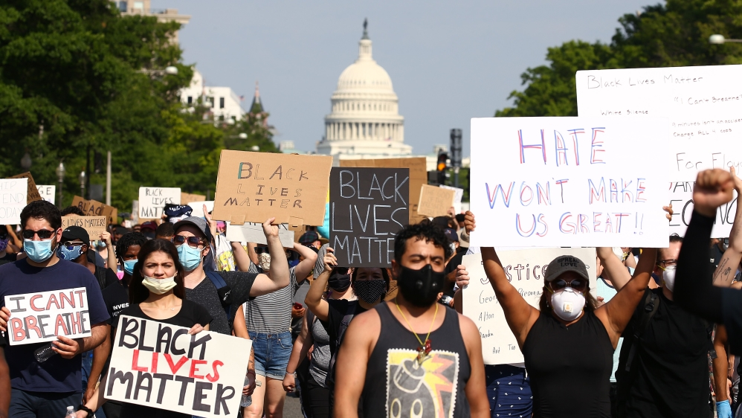
WHAT IS RACIAL JUSTICE?
Racial Justice is the systematic fair treatment of people of all races that results in equitable opportunities and outcomes for everyone. All can achieve their full potential in life regardless of race, ethnicity, or the community in which they live.
Racial Justice means having policies, beliefs, practices, attitudes, and actions that promote and integrate equal opportunity and treatment for people of all races with an extreme focus on Black Indigenous People of Color. It is important to note racial justice is both an individual and a governmental responsibility. It is the responsibility of you to believe in and support racial justice as it is even more important for the government to promote these policies and attitudes to our society.
www.OARonline.org

Slide 5
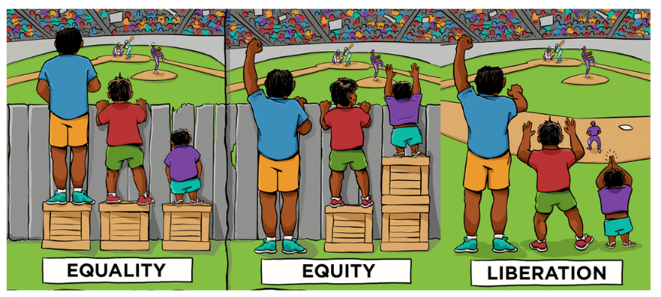
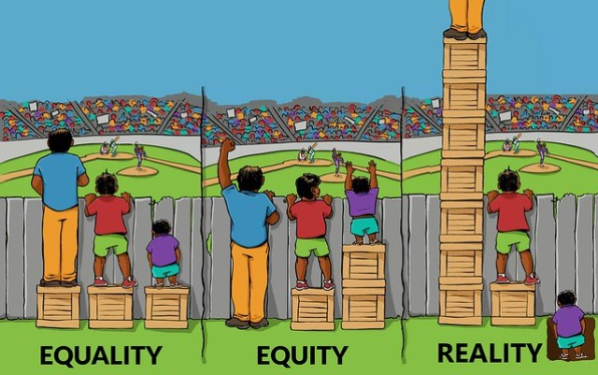
www.OARonline.org

Slide 6
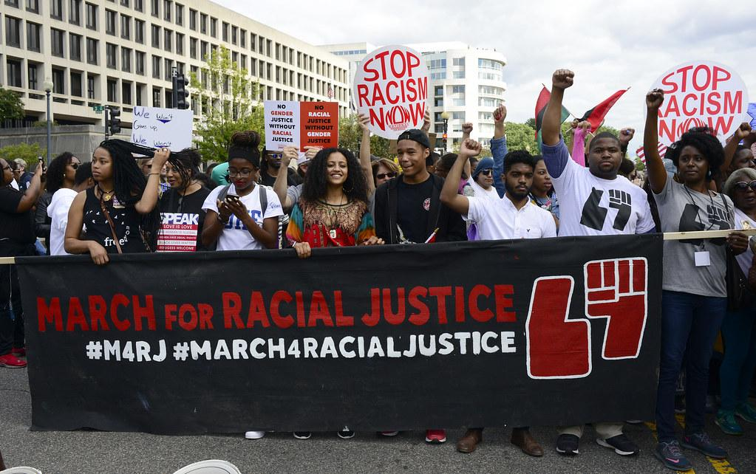
WHAT ABOUT YOUR RACIAL JUSTICE JOURNEY?
Everyday as we continue to endure and face the unfair structure our country was built upon effect lives of Black Indigenous People of color daily it makes you constantly think of two main questions; what am I doing to support this change currently and what activities can I add to my daily life to continue to implement fair change of the treatment of US into our society and everyday lives.
Your own journey may feel tiresome, force a what's the point nothing is going to change anyway attitude, not effective, draining, etc. especially as we continue to wake up everyday and CONFRONT the trauma of what our country is doing to our people.
This Photo by Unknown Author is licensed under CC BY-NC-ND
www.OARonline.org

Slide 7
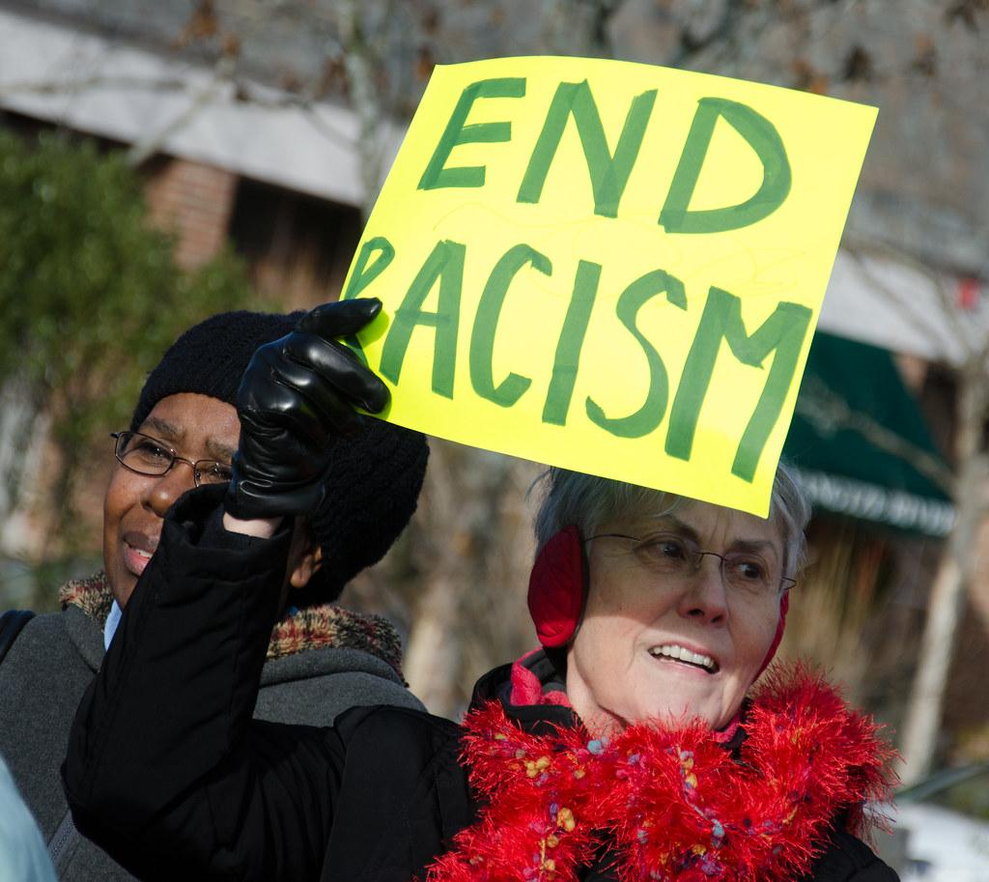
WHAT ARE SOME THINGS YOU CAN DO ON YOUR PERSONAL JOURNEY?
YOU have been making progress BY participating IN OAR’S 10 WEEK COHORT. I PERSONALLY THINK ITS IMPORTANT TO KEEP HAVING THESE DISCUSSIONS AS WE CAN TEND TO LOSE FOCUS ON OUR JOURNEY WITH OUR DAILY LIVES BEING SO BUSY. THESE COHORTS KEEPS US AS BIPOC CONSTANTLY THINKING OF NEW WAYS TO HELP AND PUSH OUR JOURNEY as well as provide a comfortable space for us to come together collectively and have these tough conversations while finding new ways to confront racism in our communities.
Examining how choices are being made around your workplace and how everyone including yourself responds to emails, one on one meetings, overall conversation and making it a priority to hear and include BIPOC.
Setting reminders each day to dedicate time to racial justice, this helps in holding yourself accountable to your journey.
Educate yourself. On our OAR website we have racial justice resources listed that are continuously updated to help you constantly learn more while on your journey.
This Photo by Unknown Author is licensed under CC BY
www.OARonline.org

Slide 8
White Racial Identity Development
Naïve Phase:
This phase is relatively neutral with respect to racial/cultural differences. Its length is brief and is marked by a naive curiosity about race.
Conformity Phase:
The White person's attitudes and beliefs in this phase are very ethnocentric. There is minimal awareness of the self as a racial being and a strong belief in the universality of values and norms governing behavior.
Dissonance Phase:
Movement into the dissonance phase occurs when the White person is forced to deal with the inconsistencies that have been compartmentalized or encounters information/experiences at odds with denial. In most cases, individuals are forced to acknowledge Whiteness at some level, to examine their own cultural values, and to see the conflict between upholding humanistic nonracist values and their contradictory behavior
www.OARonline.org

Slide 9
White Racial Identity Development (Continued)
Resistance and immersion phase :
The White person who progresses to this phase will begin to question and challenge his or her own racism. For the first time, the person begins to realize what racism is all about, and his or her eyes are suddenly open. Racism is seen everywhere (e.g., advertising, television, educational materials, interpersonal interactions). This phase of development is marked by a major questioning of one's own racism and that of others in society.
Introspective phase :
This phase is a compromise of having swung from an extreme of unconditional acceptance of White identity to a rejection of Whiteness. It is a state of relative introspection and reformulation of what it means to be White. The person realizes and no longer denies that he or she has participated in oppression and benefited from White privilege or that racism is an integral part of U.S. society.
Integrative awareness phase: :
Reaching this level of development is most characterized as (a) understanding the self as a racial/cultural being, (b) being aware of sociopolitical influences regarding racism, (c) appreciating racial/cultural diversity, and (d) becoming more committed toward eradicating oppression.
www.OARonline.org

Slide 10
Commitment to antiracist action phase :
the ultimate White privilege is the ability to acknowledge it but do nothing about it. This phase is most characterized by social action. There is likely to be a consequent change in behavior and an increased commitment toward eradicating oppression. Seeing “wrong” and actively working to “right” it requires moral fortitude and direct action. Objecting to racist jokes; trying to educate family, friends, neighbors, and coworkers about racial issues; and taking direct action to eradicate racism in the schools and workplace and in social policy (often in direct conflict with other Whites) are examples of actions taken by individuals who achieve this status.
www.OARonline.org

Slide 11
Black Indigenous People of Color Our Journey towards Psychological Liberation
Awareness/Acknowledgement of Oppression:
The first phase involves being able to see and know that oppression exists. Beyond potentially experiencing discrimination, an individual grows to understand the systemic nature of oppression. Individuals can name the ways institutions create, manage and distribute resources disproportionately and restrict opportunities for some groups while privileging others.
Awareness/Acknowledgement of Oppression on Self:
After acknowledging oppression exists comes the realization that it has a personal cost. For example, a Black woman who has appropriated the idea that she is incompetent recognizes that she has compensated by engaging in perfectionism, overworking, doubting her own competence, or being hypervigilant about feedback and criticism. The Black man who has distanced himself from “those guys” who play basketball realizes the loss of friendship his us/them attitude has created. Each of these responses has a potential impact on physical health, mental health and interpersonal relationships.
Ability to see oppression as separate from self:
This phase relates to the ability to create space and distance from the content of the dominant ideology and to observe one’s relationship with appropriated oppression. Rather than fight with the misinformation or distortions, that content can be seen for what it is, a tool of oppression that is being used and can be put to rest.
Ability to see the humanity in oneself despite oppression:
A sense of self that is not rooted in oppression can emerge and strengthen in this phase. The distance between self and content that is created through cognitive diffusion and interrogating oppression rather than accepting it allows for self reflection and exploration. This exploration might include being intentional about engaging in value directed behavior or growing in ways that were previously off-limits.
www.OARonline.org

Slide 12
Our Journey towards Psychological Liberation (Continued)
Willingness to notice/reflect on/wrestle with contradictions in real time:
The practice of noticing can create space and time for individuals to be more thoughtful about how these emerging ideas and reflections translate into everyday action stresses the importance of praxis: action, reflection, action. Contradictions will exist between what the system of oppression would have one do versus what an individual inside the process of psychological liberation would do. Being willing to stay in practice of ongoing action and reflection is a key marker of this phase. This willingness can facilitate the daily action that is necessary to implement the vision of a new narrative.
Action to create a new personal narrative towards liberation.
This phase involves developing a sense of self that is not in reaction to appropriated oppression. Not all individuals engage in political action as traditionally captured in liberation. For some individuals, personal narratives do shift as a result of being a part of collective action. Others pull away from collective action to invest in the self-care and cultivation necessary to forge a liberated narrative. intentionality, forethought, self-reactiveness and self reflection are important throughout but particularly as individuals are building a liberated psychological reality. Individuals envision and create a sense of self that is humanizing rather than dehumanizing.
www.OARonline.org

Slide 13
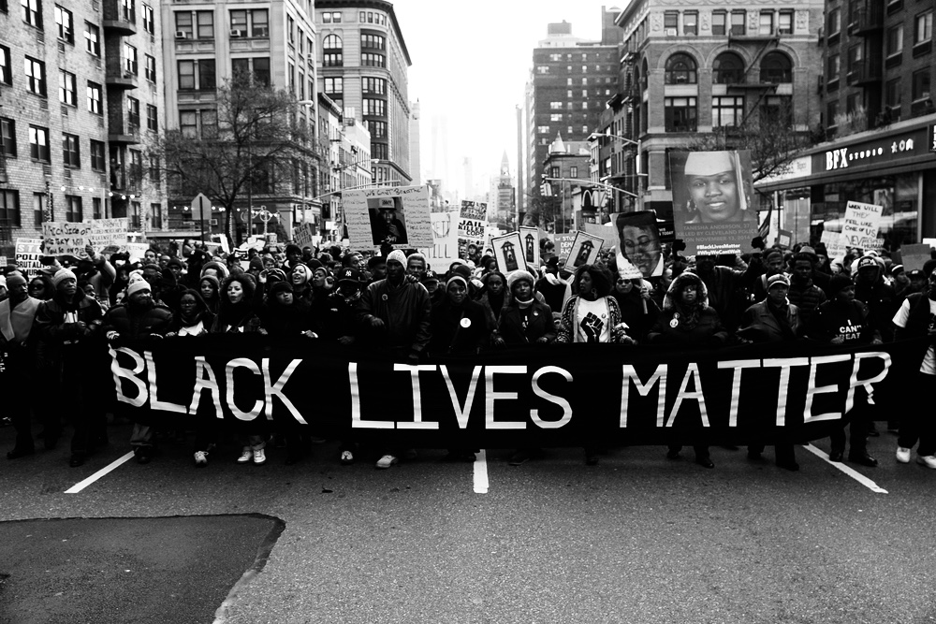
Action to transform broader systems towards liberation.
This phase represents the social, political or collective movement commonly present in liberation theories. Movement activities aimed at systemic change and working to dismantle the system of oppression
As previously mentioned, individuals can enter at any point in this Journey.
www.OARonline.org

Slide 14
APPROPRIATED RACIAL OPPRESSION
Appropriated racial oppression is a pivot in language from “internalized racial oppression” or “internalized racism” to highlight the fact that negative messages are modeled by the oppressor and broader system and are taken up, or appropriated, by the oppressed group.
www.OARonline.org

Slide 15
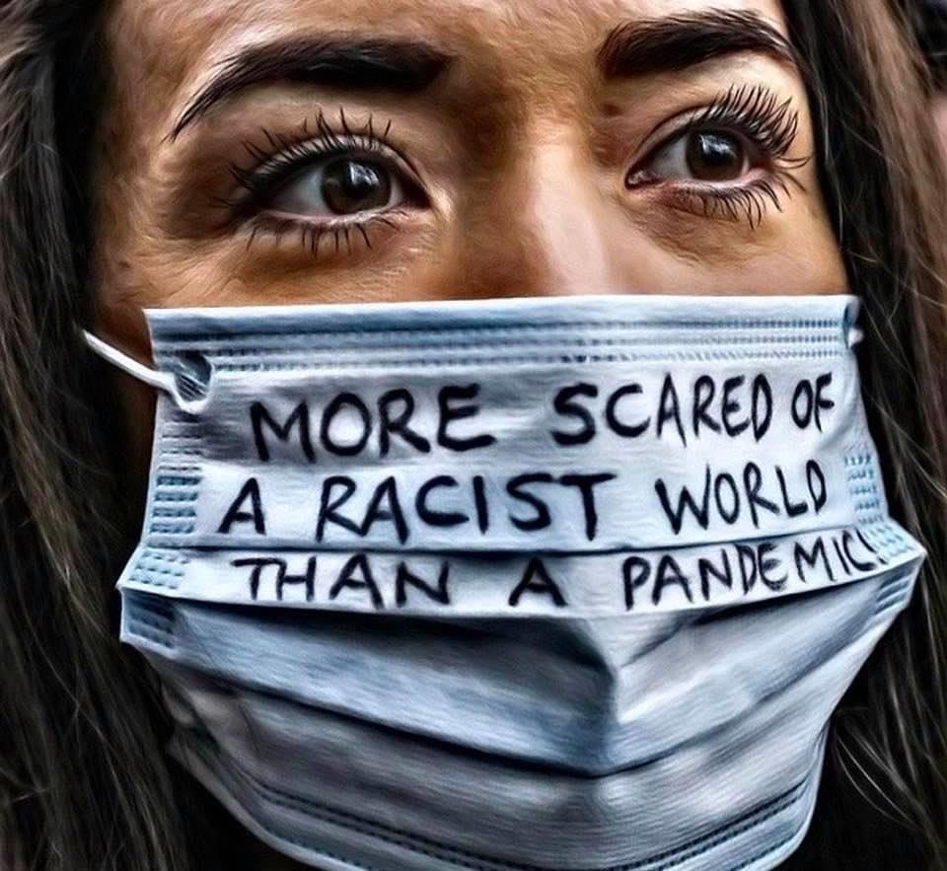
BREAKOUT GROUP QUESTIONS * NO ANSWER IS WRONG
Where would you say you are in your racial justice journey? what do you need more clarity on and what do you understand? Is there anything specific hindering your journey?
Do you think the protesting that has been occurring all over our country is an effective approach; why or why not?
www.OARonline.org

